Slide 1



I m p l e m e n t i n g S e cu r i t y M e as u r e s f or a M o b i l e B an k i n g A p p l i c a t i o n

Slide 2

I N T R O D U C T I O N
Mobile banking apps enable customers to conduct their banking operations using their mobile phones. Considering that such applications involve handling personal data about the customers, it is important that high levels of security be applied.

Slide 3

P R O B L E M S T A T E M E N T
To d a y ’ s m o b i l e b an k i n g a p p l i c a t i o n s ar e c o n f r o n t e d w i t h v ar i o u s s e cu r i t y i s s ue s t h a t i nc l u d e t h e f ol l ow i n g :
C r e d e n t i al s t h e f t
I n f or m a t i o n l e a k s
I n s uf f i c i e n t a u t h e n t i c a t i o n
U n p r ot e ct e d c o mm u n i c a t i o n
U n a u t h or i ze d a c c e s s
R ever s e e n g i n eer i n g
S uc h p r o b l e m s c an p os e r i sk s t o cu s t o m er s ’ d a t a an d f i n anc i al o p er a t i o n s .

Slide 4

P R O J E C T O B J E C T I V E S
E v al u a t e s e cu r i t y v u l n er ab i l i t i e s i n m o b i l e b an k i n g a p p l i c a t i o n s
C o n duct s t a t i c s e cu r i t y t e s t i n g
C o n duct d yn am i c s e cu r i t y t e s t i n g
D e t er m i n e v u l n er ab i l i t i e s t h a t c an b e e x p l o i t e d
S u g g e s t wa y s t o e n h anc e s e cu r i t y c o n t r ol s
E n s u r e b e t t er s e cu r i t y o f t h e a p p l i c a t i o n

Slide 5
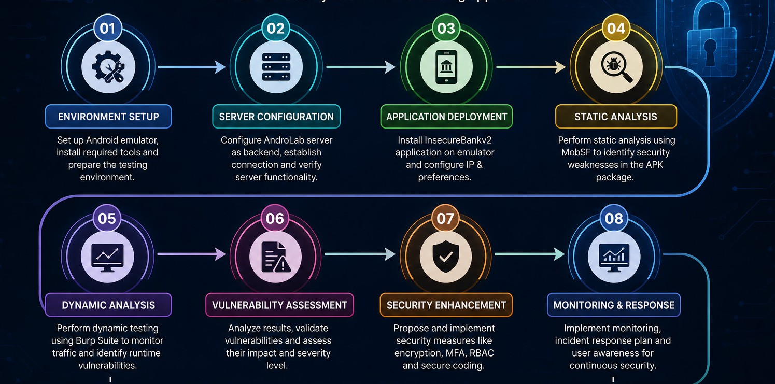

M E T H O D O L O G Y

Slide 6
Tools and Technologies Used
A number of open source security tools have been used in conducting the evaluation process. The purpose was to evaluate security vulnerabilities in the application, network communications, and backend.
Tools
MobSF
Burp Suite
Android Studio
Python 2.7
Androlab Server

Slide 7
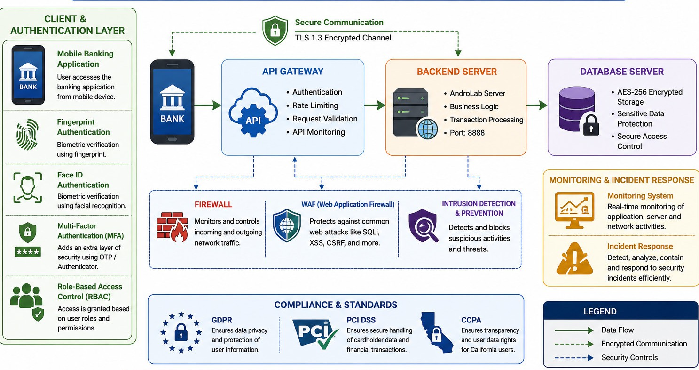
Security Architecture Overview

Slide 8
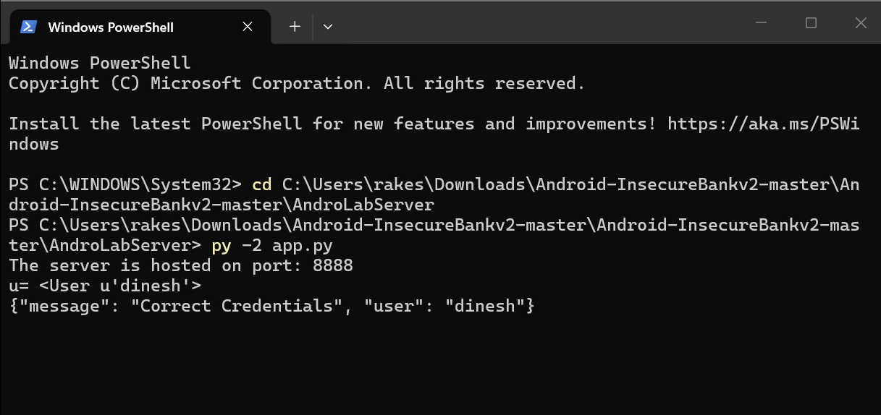
AndroLab Server Configuration
For the banking application, the AndroLab Server was configured as the backend server. It ran on port 8888. It helped in simulating authentication and transactions in the process of testing.

Slide 9
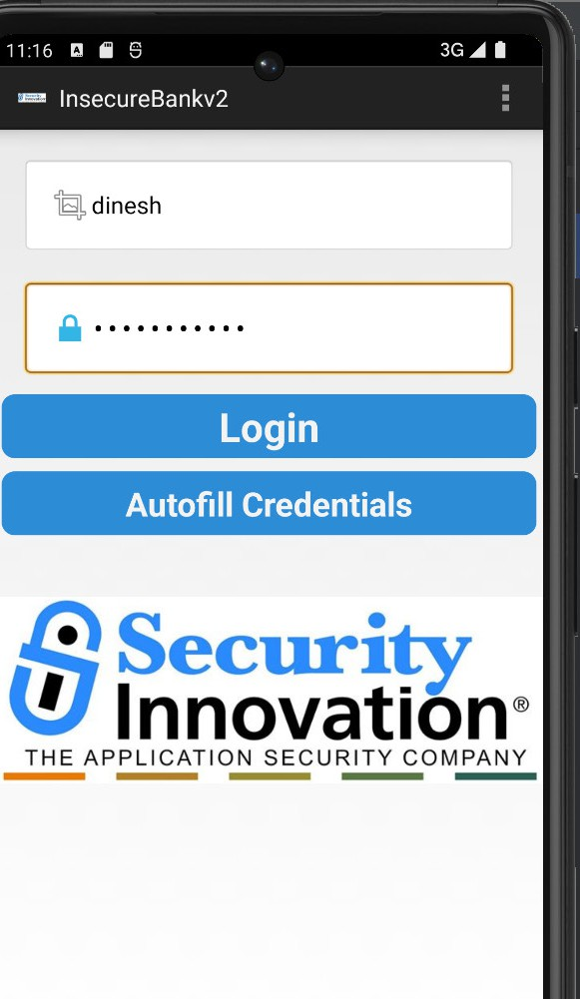
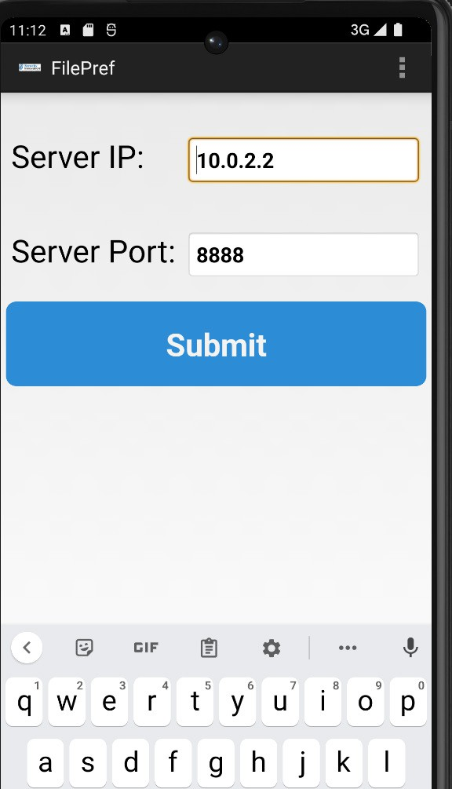
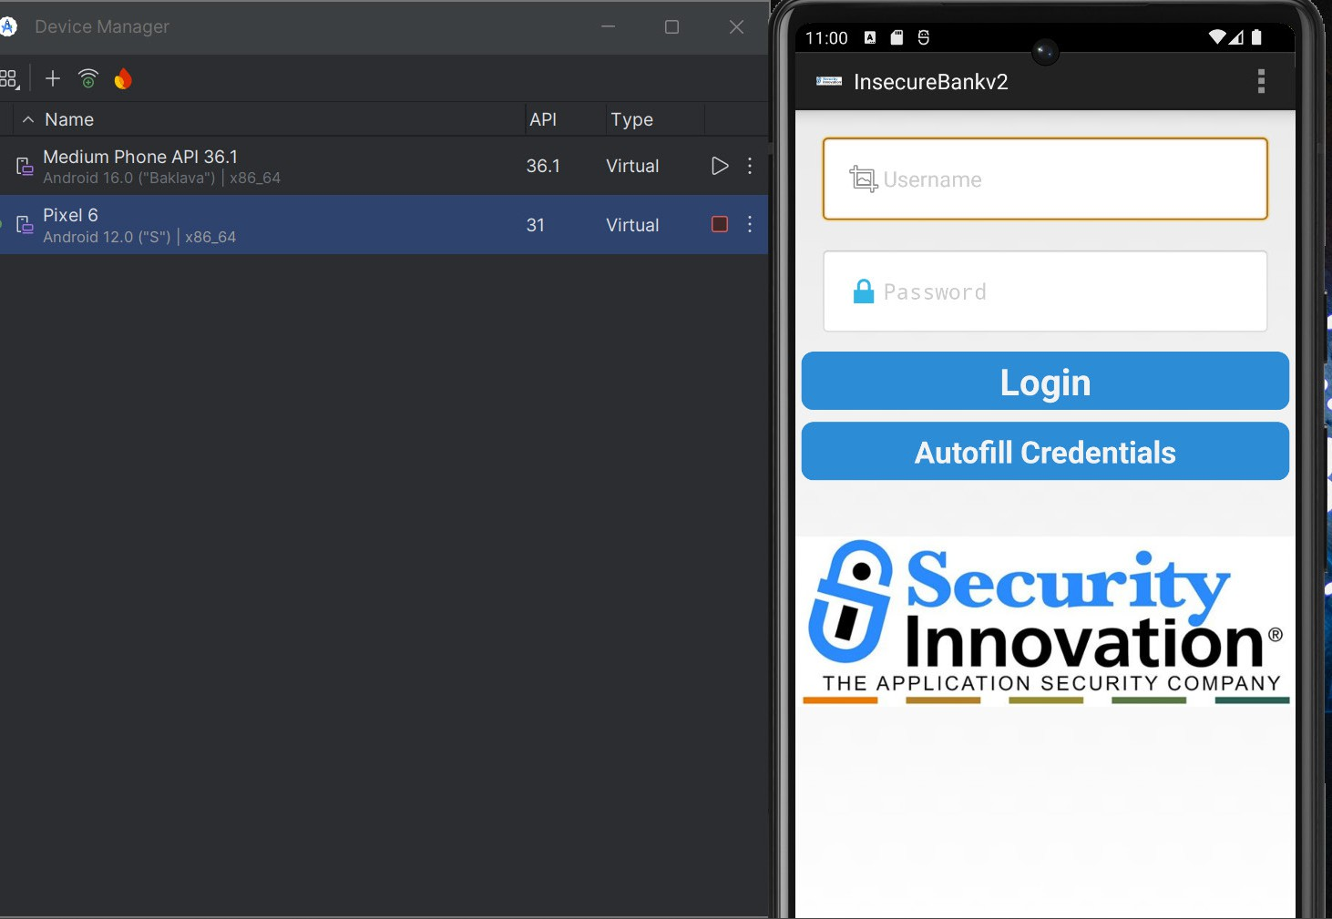
Testing Application Login
The application was deployed on an Android emulator and made to communicate with the back-end server successfully. This was confirmed from successful login tests performed.

Slide 10

STATIC CODE ANALYSIS THROUGH MobSF
Objective:
Static code analysis was conducted to detect any potential security vulnerabilities in the application package without running the application.
Areas Assessed:
Code Analysis
Permissions Assessment
Detection of Hardcoded Values
Certificate Analysis
Manifest Analysis
APK Security Checks

Slide 11
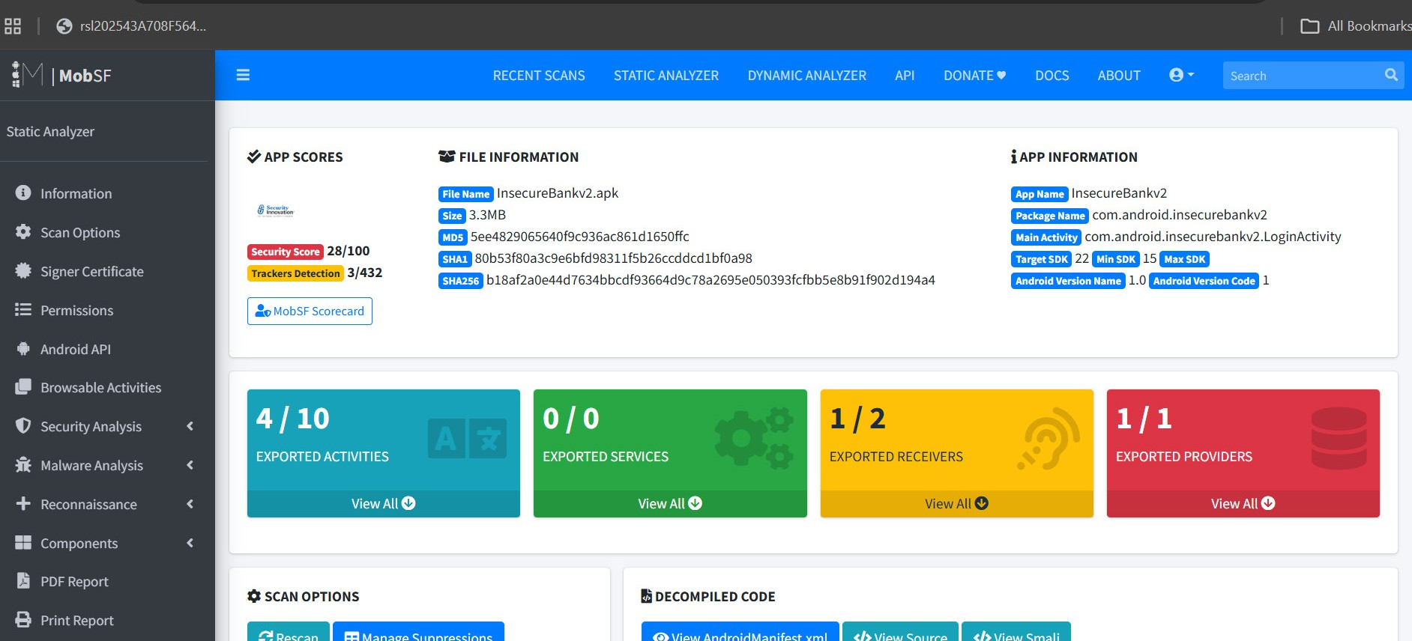
MobSF Dashboard

Slide 12

VULNERABILITY RESULTS
CRITICAL RISKS
Hardcoded Secrets
Insecure HTTP Transmission
Leakage of Confidential Information
MODERATE RISKS
Cryptographic Vulnerabilities
Debugging Capabilities in Application
Permission Overload
LOW RISKS
Configuration Risks
Security Guidelines Disregard

Slide 13
ANALYSIS OF HARD CODED SECRETS
Observations:
Many secrets have been discovered within the application package via MobSF.
Threats:
Exposed Credentials
Reverse Engineering
Unauthorized Access
Information Leaks
Effects:
Attackers can easily obtain application data through APK extraction.

Slide 14
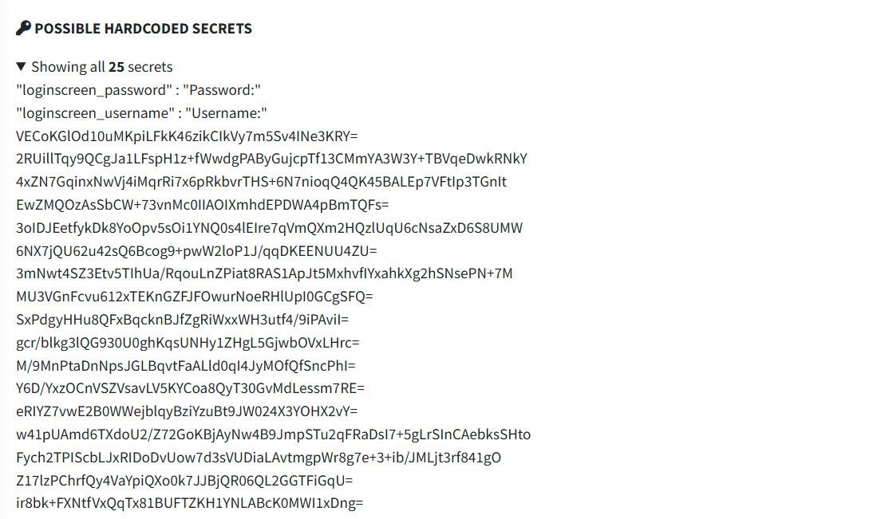
HARDCODED SECRETS

Slide 15
APPLICATION SECURITY ANALYSIS
Permissions Analysis
Upon performing permissions analysis, it was found that there was access to sensitive device components.
APK Security Analysis
Manifest Analysis
Component Analysis
Exported Activity Analysis
Security Configuration Analysis
Certificate Analysis
Checking of application signing details.

Slide 16
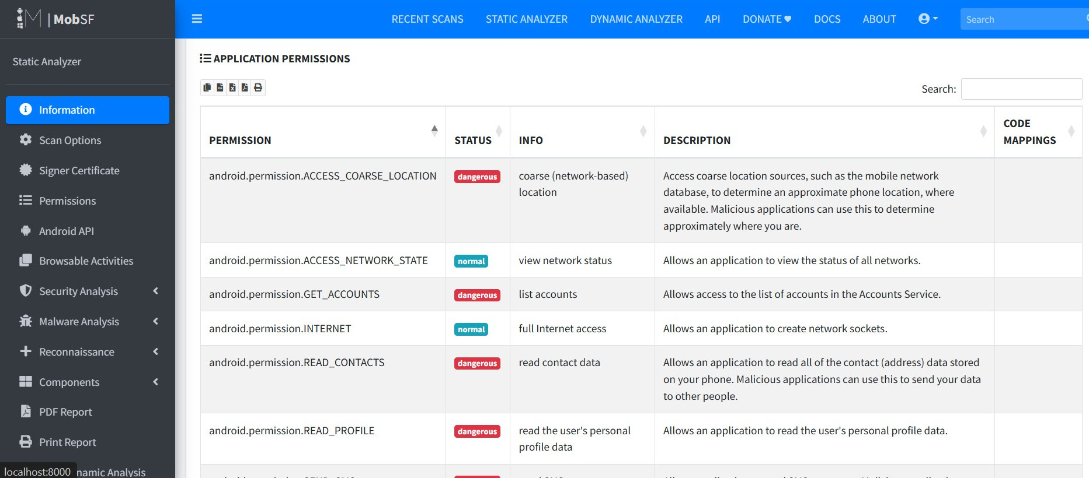
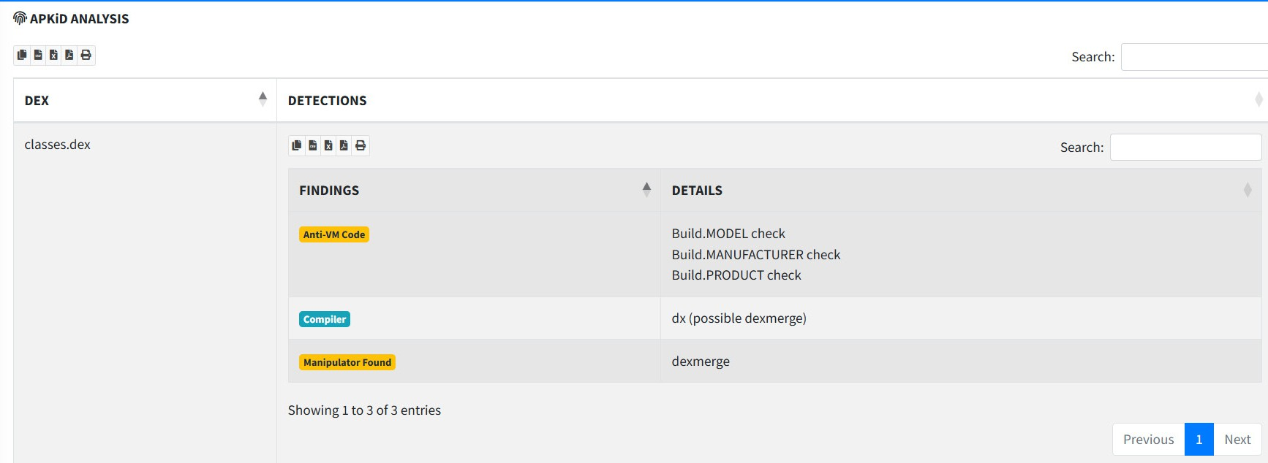
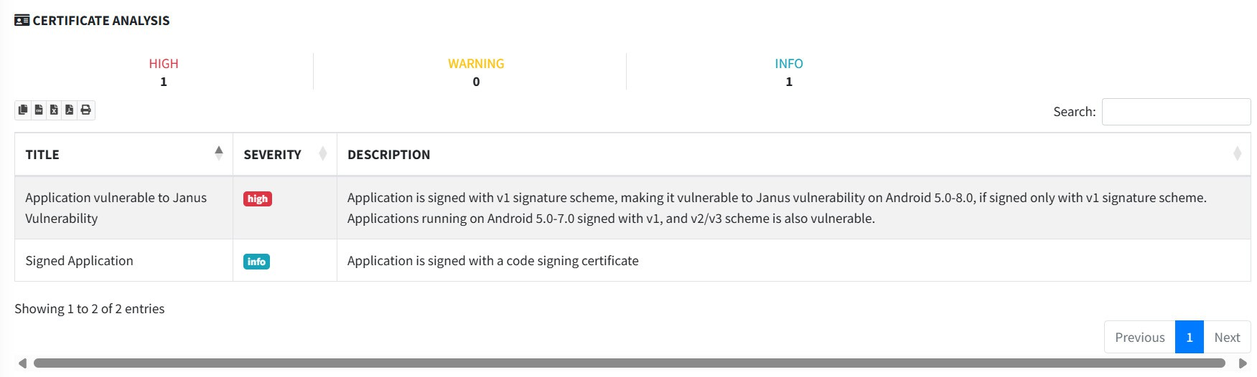
APKID
PERMISSION
CERTIFICATE ANALYSIS

Slide 17
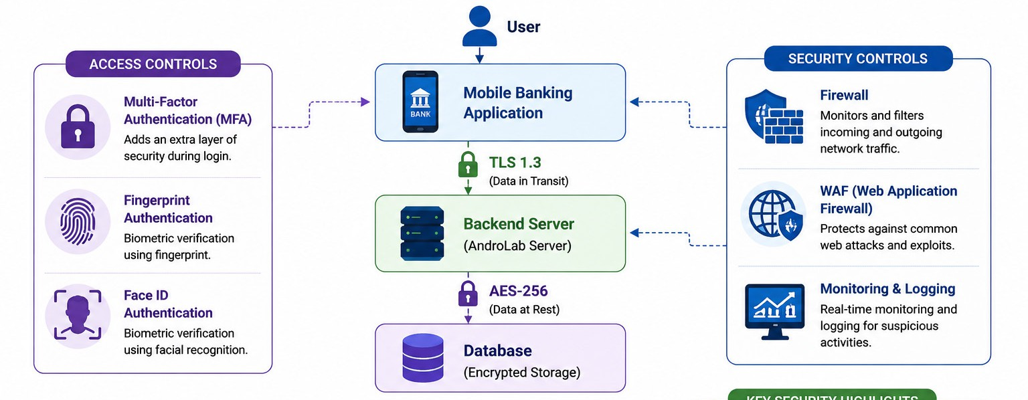
Encryption and Data Security
Any critical data needs to be encrypted using a robust encryption technology like AES-256. Any communication from the application to the server must be secure using TLS 1.3.

Slide 18
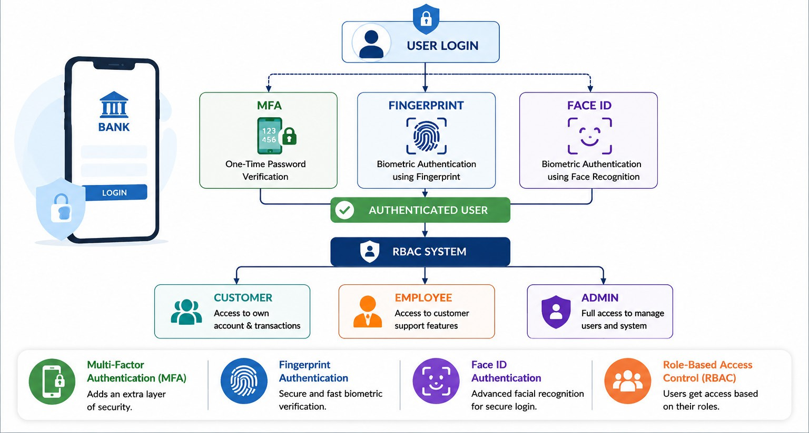
Authentication and Authorization
A strong mechanism for authentication is important to prevent unauthorized access. Multi-Factor Authentication (MFA), Fingerprint Authentication, Face ID, and Role-Based Access Control (RBAC) should be implemented for improved security

Slide 19
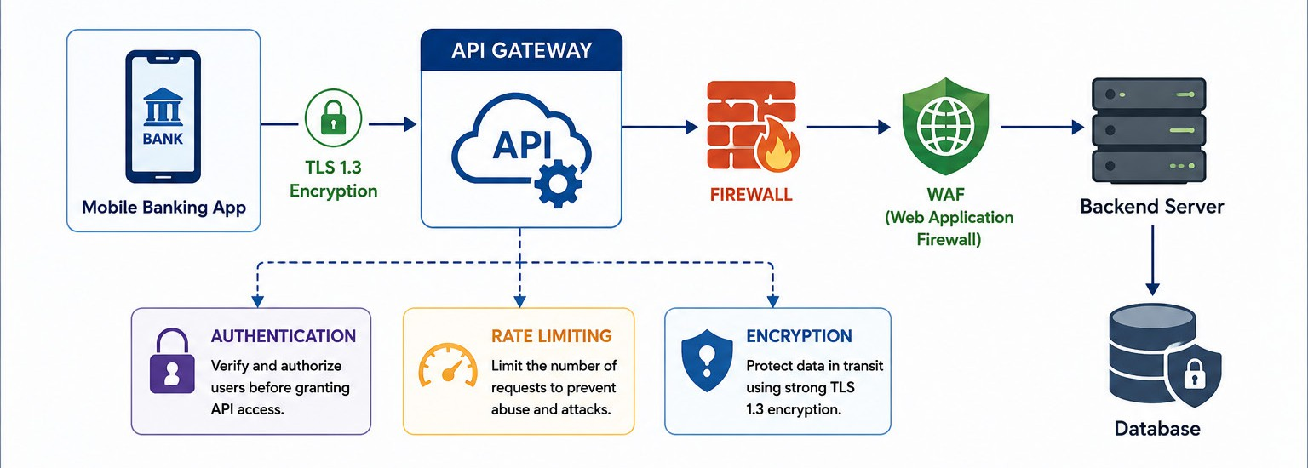
API and Network Security
The role of APIs is to ensure proper interaction between the mobile app and the backend server. In order to secure the APIs from any type of attacks or breaches, authentication, TLS, rate limiting, firewalls, and WAF should be applied.

Slide 20
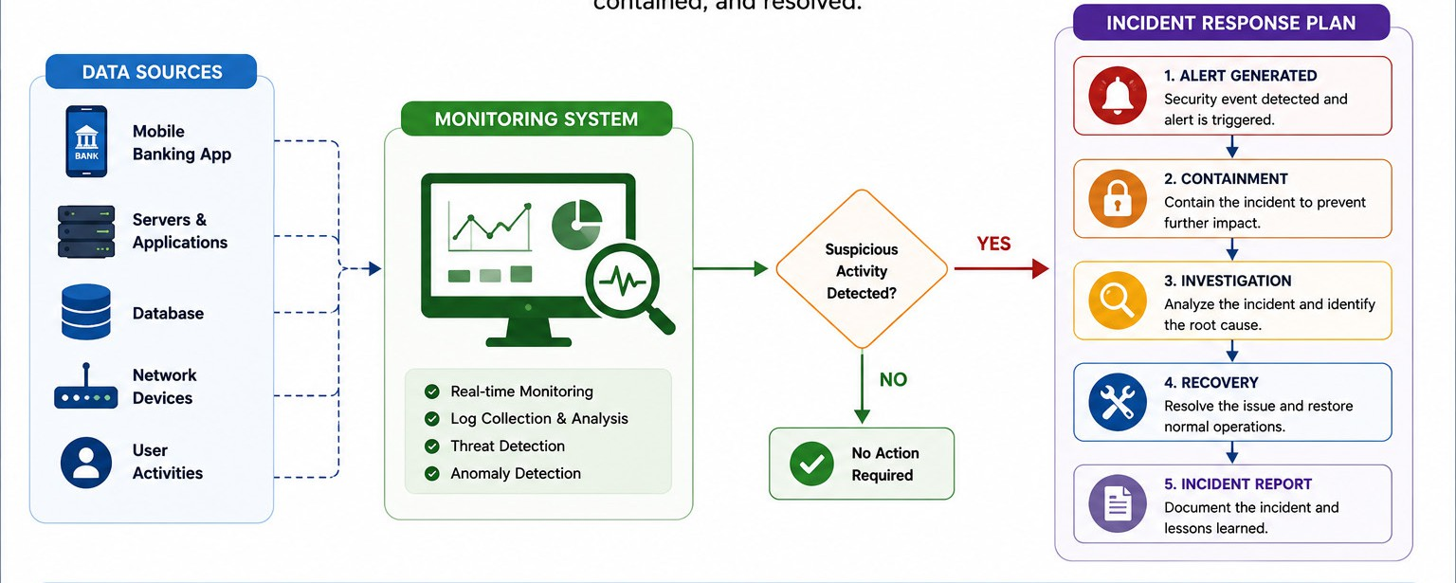
Monitoring & Incident Response
Monitoring plays an important role in discovering suspicious activities, security attacks, and unauthorized attempts to enter the organization’s premises. The incident response plan will ensure that security incidents will be promptly detected, contained, analyzed, and managed.

Slide 21
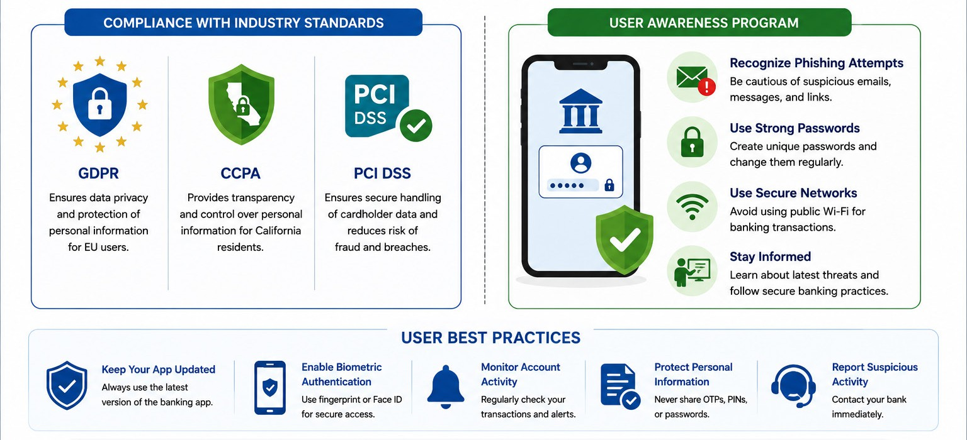
Compliance and User Awareness
Mobile banking apps must be compliant with standards like GDPR, CCPA, and PCI DSS. User awareness campaigns will aid users in recognizing phishing scams and conducting themselves securely during mobile banking operations.

Slide 22

Security Advice
Implement multi-factor authentication (MFA).
Provide fingerprint and face ID authentication capability.
Encrypt sensitive data with AES-256 encryption.
Secure communication using HTTPS and TLS 1.3.
Implement certificate pinning to stop man-in-the-middle attacks.
Do not include any hard-coded secrets in the app.
Make APIs safer through authentication and rate limiting.

Slide 23
CONCLUSION
The project was able to uncover the vulnerabilities of the application in terms of its security aspects, along with providing effective security controls for the risks posed by the mobile banking application. Through encryption, MFA, biometrics, secure API integration, and constant monitoring, the application will be able to offer secure and reliable banking services.

Slide 24

FUTURE SCOPE
Artificial Intelligence & Machine Learning Enabled Fraud Prevention
Behavioral Biometrics for Authentications
Blockchain Technology for Secure Financial Transactions
Threat Monitoring & SOC Integration
Cloud Security
Automated Incident Response System
Mobile Threat Defense (MTD)
Continual Monitoring of Regulatory Compliance (GDPR, PCI DSS)

Slide 25
THANK YOU

